Slide 1

Embed Prototype Reel

Slide 2

SpecSynth.AI
The AI-Empowered Enterprise Data Engine.
Bridging the gap between static manufacturer data and live BIM geometry to enforce compliance and design with absolute certainty.
Founding Team: Kazuko, Fawad, Soumya

Slide 3
THE INDUSTRY DATA FAILURE
$177B
REVIT MATERIAL IDENTITY
Generic Wall Insulation
U-Value: Undefined
Annual loss to design rework. ¹
70%
Driven by specification errors. ²
PDF MANUFACTURER SPEC
Magon Master PIR 100mm
We build geometrically perfect 3D models, but populate them with unverified, disconnected data buried four menus deep
λ = 0.020 W/(m·K)
1 PlanGrid & FMI Corporation Industry Report ("Construction Disconnected: The High Cost of Poor Data and Miscommunication")
2 Source: Navigant Construction Forum / Autodesk Industry Benchmarks (confirmed further by the PlanRadar QA/QC Impact Report).

Slide 4
THE ENTERPRISE ECOSYSTEM VISION
Scaling from static files to connected intelligence
PHASE 1 INPUTS
PHASE 1 OUTPUT
R
Autodesk Revit
PDF Specs
SpecSynth.AI
PHASE 2 EXPANSION
Excel Data
F
AutoCAD
PHASE 2 DATA SOURCES
A
Archicad
PIM
EPD Registries
N
Navisworks

Slide 5
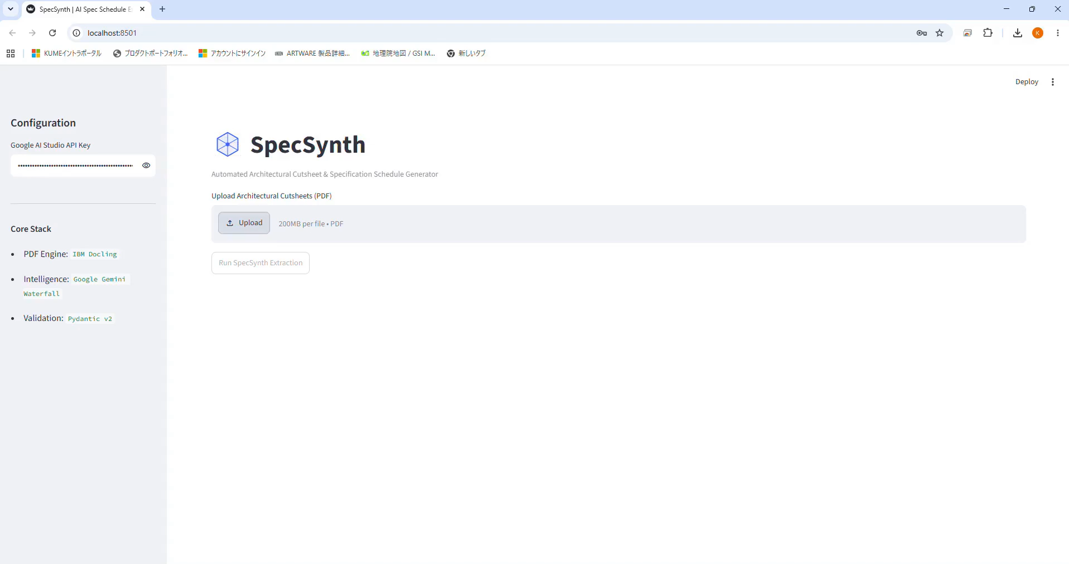
Embed Intro Reel

Slide 6
AI PRODUCT INGESTION: COMPUTER VISION & OCR
From unstructured PDF to structured logic
app.specsynth.ai / library / insulation
CATALOGS
Verified Materials
+ Upload PDFs
Thermal Insulation
Acoustic Panels
Magon Metales
VERIFIED
Kingspan
VERIFIED
Master Basic PIR
Kooltherm K108
Exterior Cladding
Thermal (λ):
0.020 W/(m·K)
Thermal (λ):
0.018 W/(m·K)
Fire Rating:
B-s1, d0
Fire Rating:
Euroclass C

Slide 7

SPATIAL BIM COMPLIANCE
AI-powered inspection natively inside Revit
Architecture
Structure
SpecSynth.AI
Inspect
Export
Insulation Inspection
Selected Element
SSAI_ExternalWall_FAIL
Code Target limit:
0.022 W/(m·K)
Product Value:
0.028 W/(m·K)
COMPLIANCE RESULT: FAIL

Slide 8
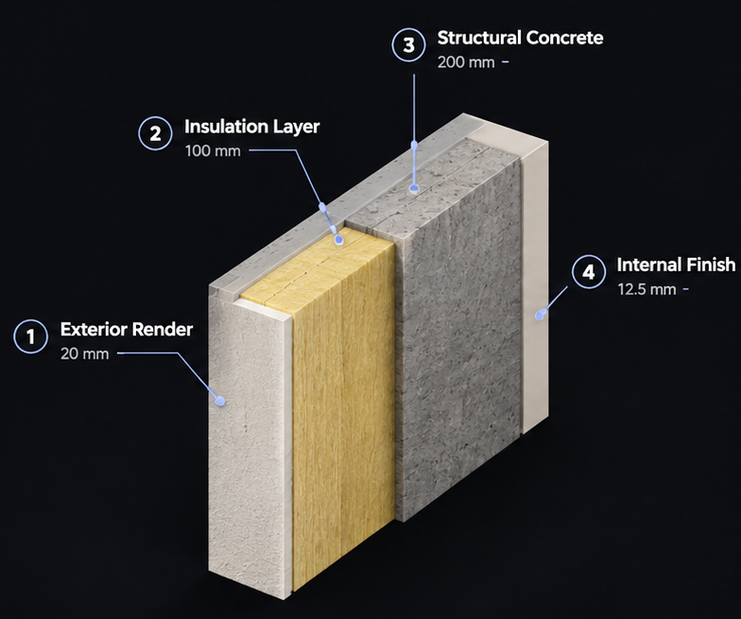
MULTI-LAYER ASSEMBLY
Evaluating aggregate performance, layer by layer
Architecture
Structure
SpecSynth.AI
Inspect
Export
Layer Evaluation
Thickness
Status
1
Exterior Render
20 mm
PASS
Cement Render | Passive
2
Insulation Layer
100 mm
FAIL
Thermal Insulation (PIR)
3
Structural Concrete
200 mm
PASS
Reinforced Concrete | Core Support
4
Internal Finish
12.5 mm
PASS
Gypsum Board | Interior Lining
U-Value
Total Thickness
Overall Status
0.42 W/m²·K
332.5 mm
FAIL
Target: ≤ 0.30
4 Layers

Slide 9
AI-POWERED AUTOMATION
Compute compliance at scale
Export comprehensive Thermal Schedules cross-referencing hundreds of wall assemblies simultaneously. Let AI eliminate manual counting and eradicate specification risk.
Wall_Type
Product_Mapped
Thermal_W_mK
VerificationStatus
ExtWall_01_Main
Magon Master Basic PIR
0.020
PASS
ExtWall_02_Rear
Generic_Insulation_X
0.028
FAIL
Int_Acoustic_04
N/A (Missing Data)
--
CANNOT VERIFY

Slide 10

AI DESIGN ASSISTANT
Conversational engineering
"Find a wall assembly that meets U-value ≤ 0.25 and reduces carbon."
SpecSynth Agent
Here are recommended options based on your loaded catalog:
Option C (Recommended)
U-value: 0.23 | Carbon: -22%
APPLY TO REVIT

Slide 11



THE ECONOMICS OF PRECISION
The ROI of absolute design certainty
IDS Checked
CO₂ Reduction
10 min vs 48 min
92%
-18%
4.8x
Model Compliance
Embodied Carbon
Audit Velocity
Model information quality achieved pre-tender through automated BIM checking rules.
Average reduction unlocked via automated material substitution and assembly optimization.
Faster quality assurance and compliance evaluation compared to manual document checks.
Benchmark: 85–95% on rule-based projects
Benchmark: 10–30% early design savings
Benchmark: 3–6x acceleration in QA cycles

Slide 12
COMPETITIVE MOAT
Physics-grade verification vs. pure geometry
CAPABILITY
Clash Engines
SpecSynth.AI
Automated PDF Data Extraction
Live 3D Viewport Heatmapping
Geometry Only
(Physics)
Carbon vs. Cost Optimization AI

Slide 13
ADDRESSABLE MARKET
$29.9B TAM
Propelled by strict global green taxonomy mandates, the transition from 2D CAD to semantic BIM is forcing studios to adopt automated compliance enforcement.
2026 BASE MARKET
CAGR (2026-2034)
$11.1B
13.2%
Source: IMARC Group Market Research ("Building Information Modeling (BIM) Market Size, Share, Growth, and Forecast 2026–2034").

Slide 14
Build with absolute certainty.
Raising $250K Pre-seed to build MVP, enable native BIM integrations and deploy initial Top-50 studio design pilot (1 investment-grade customer)
founders@specsynth.ai
Foundry@22 // Barcelona
Chicago • Tokyo • Bangalore

Slide 15
Appendix

Slide 16



STRATEGIC OVERVIEW
Core Business Model
SaaS Subscription & Ecosystem Monetization
CORE ENGINE
ECOSYSTEM
ADOPTION
RETENTION
Subscription SaaS
App Marketplace
Advisory & Setup
Premium Support
$49 / user / mo
30% rev-share
$18k+ one-time
20% of ARR
Predictable recurring user licenses across tiered enterprise editions
Revenue share on third-party integrations and developer add-ons
High-margin onboarding, custom implementation, and training contracts
Mission-critical SLA agreements and 24/7 dedicated engineering tiers
KEY ECONOMIC DRIVER
Net Revenue Retention (NRR) driven by multi-cloud expansion and usage tiers

